Slide 1
SMARTPHONES
Why do we need multivariate analysis ?
How can we use multivariate analysis to increase sales?
How can we formulate a reasonable marketing strategy?

Slide 2
DATA
DATA 1
For data 1 we have COUNTRIES as rows
And columns are variables related to smartphone usage
DATA 2
Rows = COUNTRIES
Cols= GDP , POPULATION & SOCIETAL FACTORS

Slide 3
PCA
LET’S TALK TO OUR DATA 1 USING PCA

Slide 4
COR PLOT
1
pd
0.8
-0.35
apps
0.6
0.4
-0.27
0.8
appsmon
0.2
0.29
0.31
0.28
FEUL
0
-0.2
0.19
0.35
0.32
0.99
FEUM
-0.4
-0.07
0.32
0.43
0.48
0.52
FEULc
-0.6
-0.22
0.25
0.33
0.37
0.43
0.94
FEULc
-0.8
-1

Slide 5
Names of the variables
(PD)Smartphone purchase decision
(apps)Number of apps on phone
(appsmon)Number of apps used in last 30 days
(FEUL)Frequency of email use on smartphone_liekert
(FEUM)Frequency of email use on smartphone_Month
(FEULc)Frequency of email use on Computer_liekert
(FEULc)Frequency of email use on Computer_Month

Slide 6
SCREE PLOT
Explained Variance per Dimension
50
3.5
40
3.0
2.5
30
2.0
Percentage of Explained Variance
Inertia Extracted by the Components
20
1.5
1.0
10
0.5
0
0.0
1
2
3
4
5
6
7
Dimensions

Slide 7
PROJECTIONS
Smartphones Row Factor Scores
IND
%
0.5
24
=
τ
IDN
.
THA
ZAF
ARG
1.702
CHN
MEX
=
BRA
λ
MYS
USA
2
.
0.0
TUR
ITA
SGP
JPN
CZE
GBR
SAU
IRL
Component
RUS
TW
DEU
AUT
FIN
NLD
CHE
SWE
DNK
FRA
-0.5
NOR
-0.5
Component
0.0
%
0.5
1
.
λ
=
3.407
.
τ
=
49

Slide 8
BOOTSTRAP
Smartphones Row Factor Scores
%
0.5
24
=
τ
.
Africa
1.702
South America
=
North America
λ
Asia
2
.
0.0
Component
Europe
-0.5
-0.5
Component
0.0
%
0.5
1
.
λ
=
3.407
.
τ
=
49

Slide 9
TOLERANCE
Smartphones Row Factor Scores
%
0.5
24
=
τ
.
Africa
1.702
South America
=
North America
λ
Asia
2
.
0.0
Component
Europe
-0.5
-0.5
Component
0.0
%
0.5
1
.
λ
=
3.407
.
τ
=
49

Slide 10
Loadings
1.0
pd
FEUL
0.5
FEUM
Component 2
FEULc
0.0
FEULc.1
-0.5
appsmon
apps
-1.0
-1.0
-0.5
0.0
0.5
1.0
Component 1

Slide 11
CONCLUSION
Europe is different from rest of the continents in terms of purchase decision and usage of smartphones.
Countries from Asia and South America show same usage patterns.
Purchase decision is inversely related to the apps on mobile
Purchase decision is directly related to frequency of phone usage for emails
Purchase decision is not related to frequency of Computer usage for emails.

Slide 12
IS THE CONCLUSION RELIABLE ?
Barplots for variables
Contribution barplots
Component 1: Variable Contributions (Signed)
Component 2: Variable Contributions (Signed)
0.4
0.4
appsmon
FEULc
pd
apps
Contributions
Contributions
0.0
0.0
pd
apps
FEUL
FEUM
FEULc
FEULc
FEUL
FEUM
FEULc
-0.4
appsmon
-0.4
Bootstrap ratios
Component 1
Component 2
6
5.0
3
2.5
appsmon
FEULc
pd
apps
Bootstrap ratios
Bootstrap ratios
0
0.0
pd
apps
FEUL
FEUM
FEULc
FEULc
FEUL
FEUM
FEULc
-3
appsmon
-2.5
-6
-5.0

Slide 13
MCA
WHAT CAN MCA TELL US ABOUT DATA 1?

Slide 14
COR PLOT
1
pd
0.8
0.22
apps
0.6
0.4
0.22
0.71
appsmon
0.2
0.28
0.29
0.3
FEULP
0
-0.2
0.25
0.24
0.31
0.8
FEUPM
-0.4
0.28
0.24
0.36
0.21
0.34
FEULc
-0.6
0.28
0.3
0.3
0.28
0.31
0.64
FEUMc
-0.8
-1

Slide 15
SCREE PLOT
Explained Variance per Dimension
70
0.15
60
50
0.10
40
Percentage of Explained Variance
Inertia Extracted by the Components
30
20
0.05
10
0
0.00
1
2
3
4
5
Dimensions

Slide 16
PROJECTING COUNTRIES
MCA: Smartphones Data Set
0.6
GBR
ITA
NLD
%
24
0.3
AUT
=
DEU
τ
CHN
CHE
.
SWE
0.053
THA
=
MEX
λ
0.0
MYS
TW
FRA
2
.
NOR
DNK
BRA
IDN
SGP
JPN
TUR
SAU
USA
IRL
Dimension
RUS
ZAF
IND
-0.3
CZE
FIN
ARG
-0.5
0.0
0.5
Dimension
1
.
λ
=
0.137
.
τ
=
62
%

Slide 17
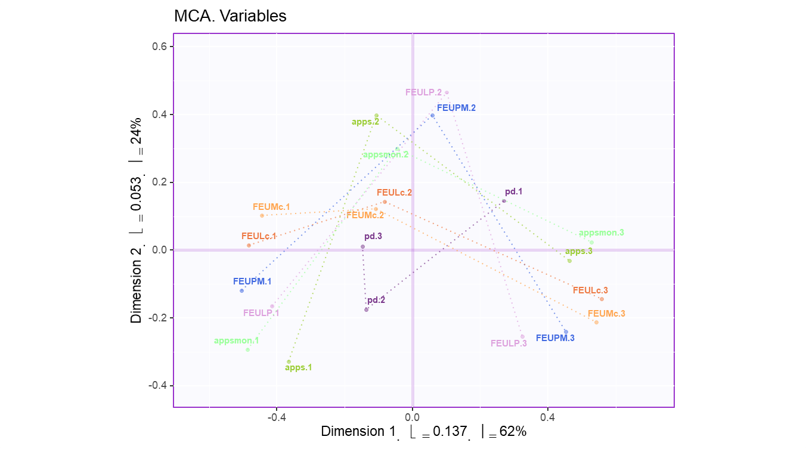
PROJECTING VARIABLES

Slide 18
CONCLUSION
When we project our observations onto the two components we can say that the developed and developing countries purchase and use smartphones differently. (same as in pca)
PD 1 is explained by DIM 1
PD2 is explained by DIM 2 AND DIM 1
PD 3 is explained more by DIM 1

Slide 19
Reliability test?
FINGERS CROSSED

Slide 20
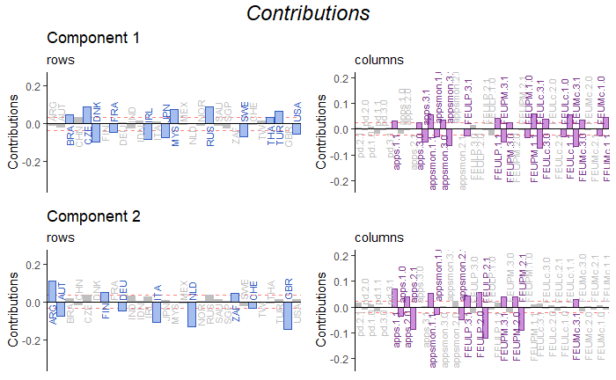

Slide 21
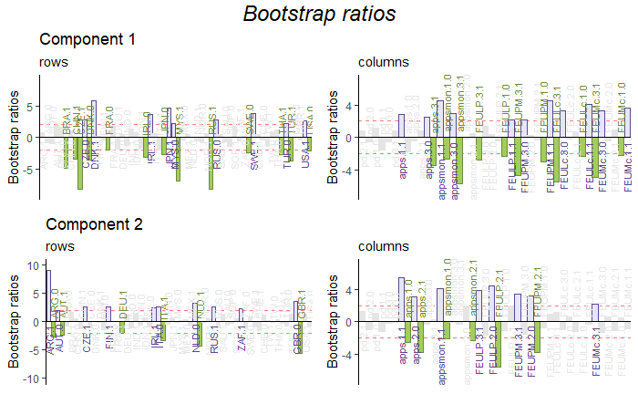

Slide 22
BADA
IT’S YOUR TURN CHAMP GO FOR IT
(DATA1)

Slide 23
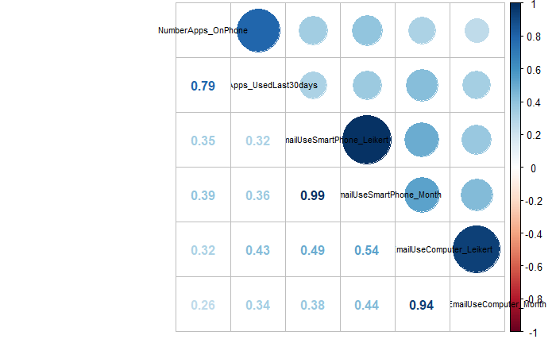
DID YOU NOTICE THE CHANGE?

Slide 24
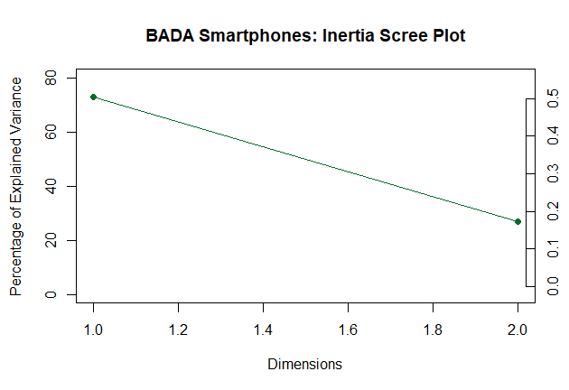

Slide 25
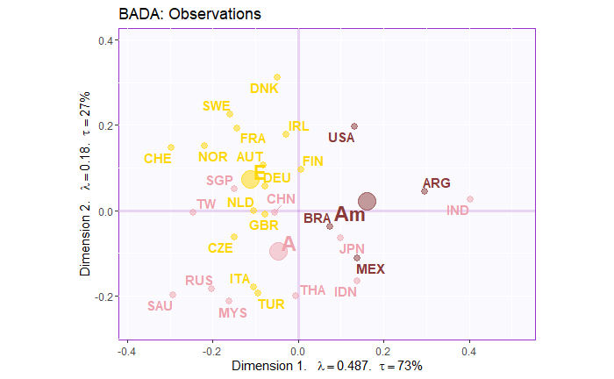
COUNTRIES & CONTINENTS

Slide 26
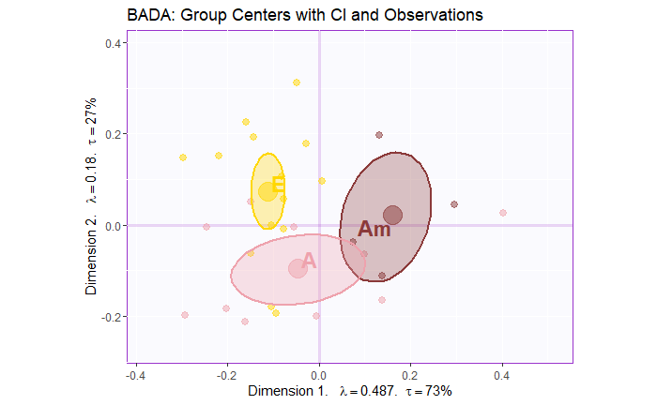
CONFIDENCE INTERVALS

Slide 27
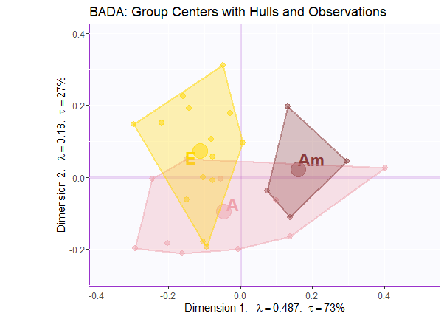

Slide 28
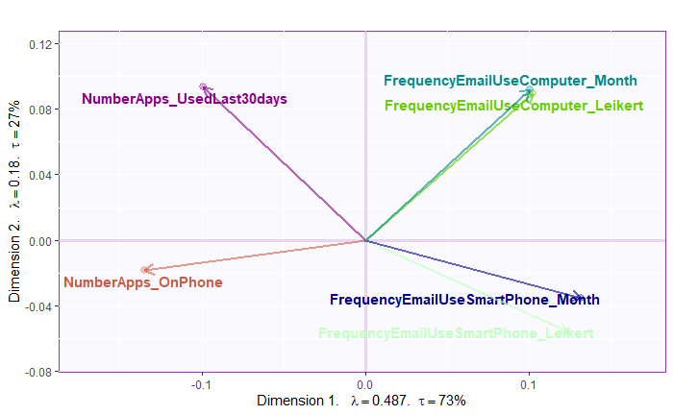
LOADINGS

Slide 29
CONCLUSION
This plot shows that asian and american countries slightly overlap but europian countries are away from them.
Few european and american countries overlap with asian countries
If other apps are used more on the phone email app would be used less and vice versa
If more apps are there on the phone, computer email usage would be less and vice versa

Slide 30
ARE YOU SURE?
NOT YET.

Slide 31
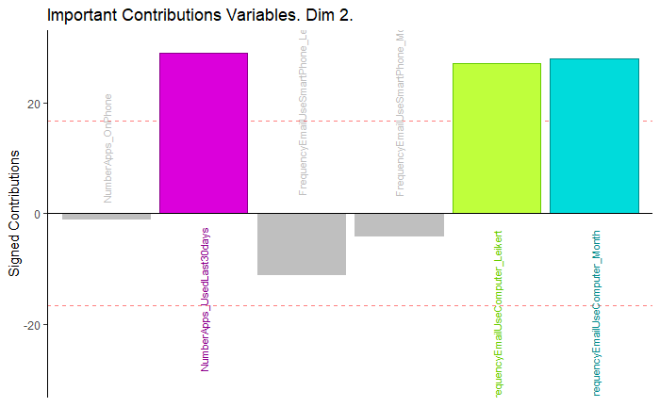
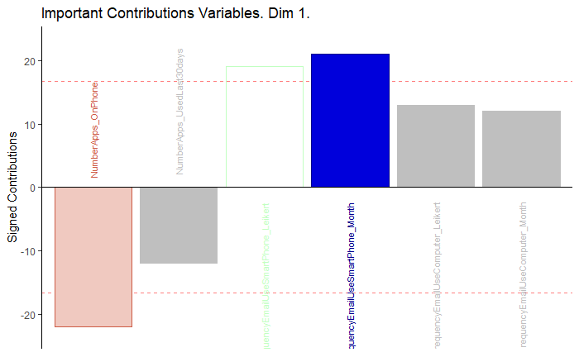

Slide 32
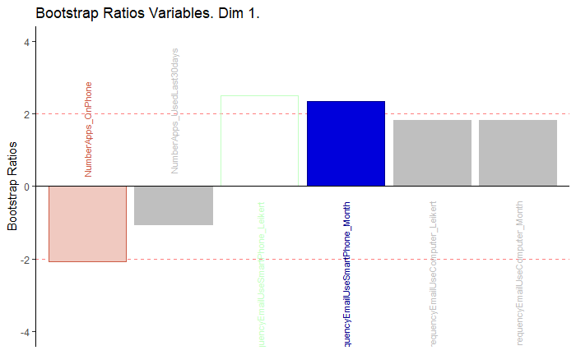
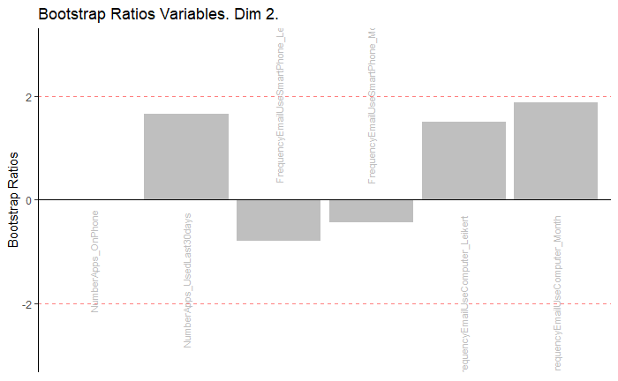

Slide 33
DICA
DATA 1

Slide 34
COR PLOT

Slide 35
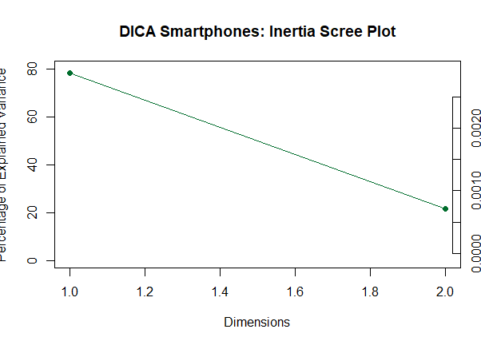

Slide 36
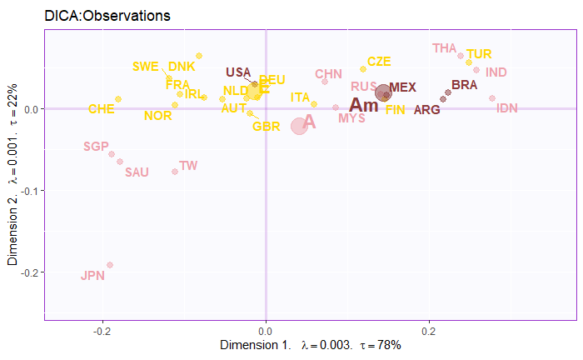

Slide 37
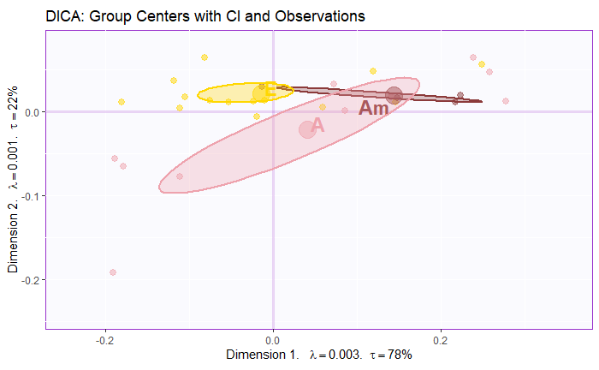

Slide 38
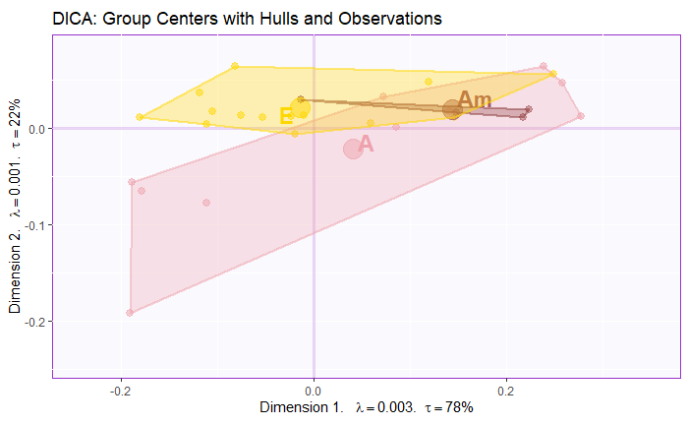

Slide 39
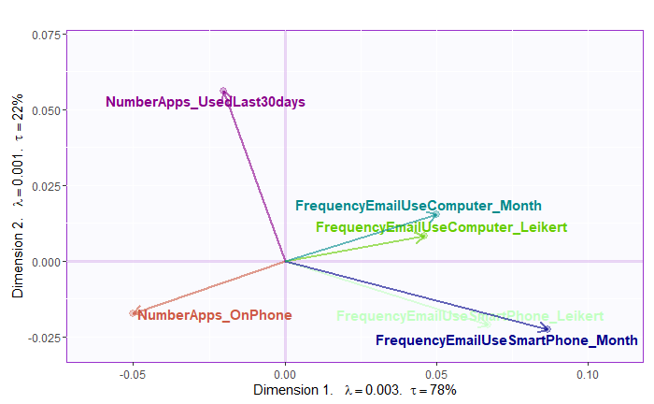
LOADINGS

Slide 40
CONCLUSION
Most of the countries are spread out across the first component.
Few countries from American continent show similar usage of smart phones like Asian and European
As there are developed and developing countries in American continent
Loadings :
Interpretations are same as BADA.

Slide 41
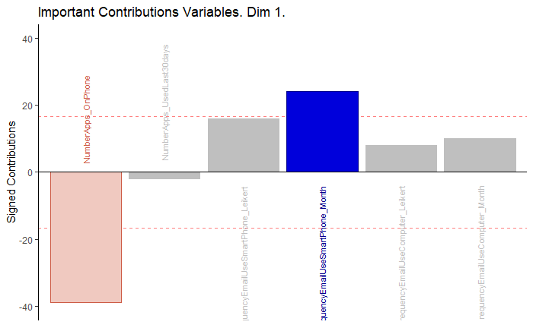
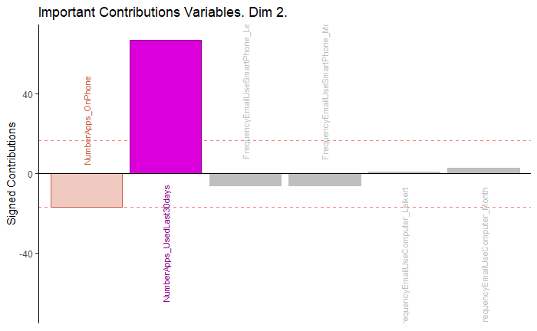

Slide 42
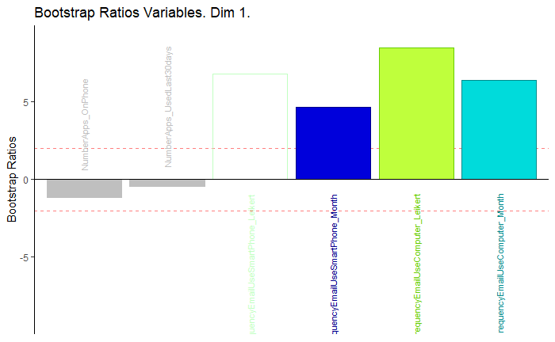
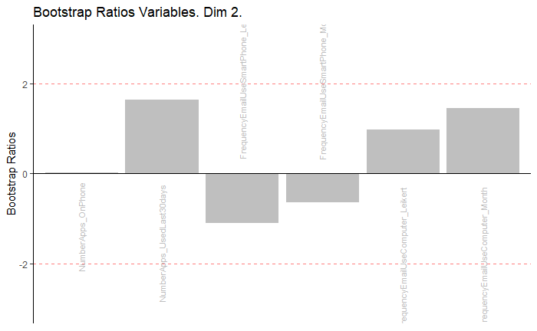

Slide 43
PLSC
Now that we know how countries of different continents use smartphones.
We can analysis these countries on other factors such as population and GDP to get more information.
The dataset which we would use for PLSC is data 2.

Slide 44

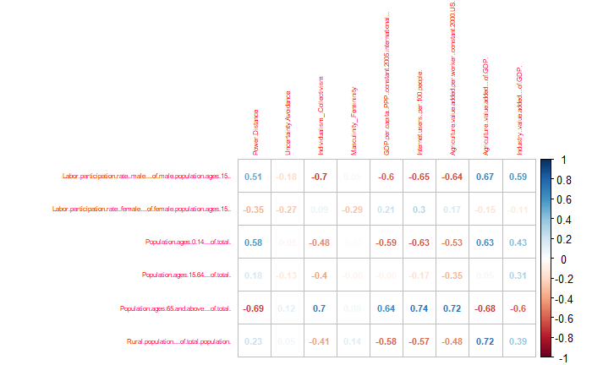

Slide 45
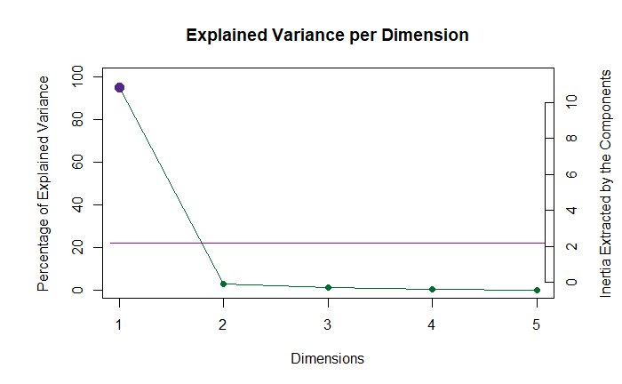

Slide 46
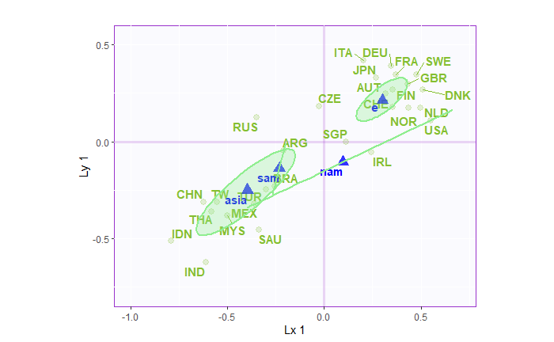
LATENT VARIABLE 1

Slide 47
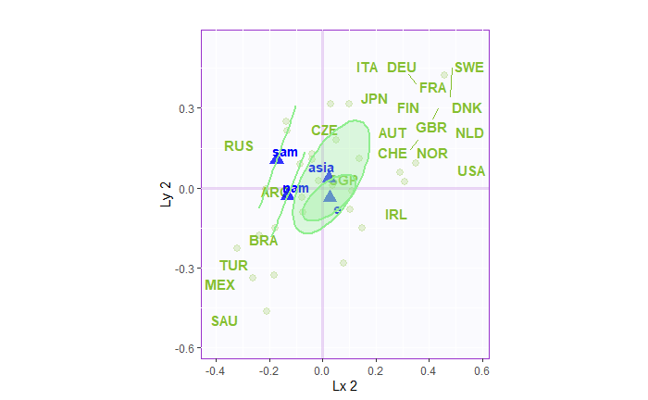
LATENT VARIABLE 2

Slide 48
CONCLUSION
From the plot lx1 and ly1 it is evident that South America and Asia are closer and, Europe and North America are closer.
This implies that rich countries have similar economical and population factors and developing countries have similar economical and population factors so grouping them as per GDP would make more sense.
From the plot lx2 and ly2 it is evident that all continents are pretty close to each other however we cannot conclude anything as latent variable 2 is not significant.
From PCA and PLSC analysis we can have an hypothesis that smartphones sales is mainly related to the population factors and economical factors.

Slide 49
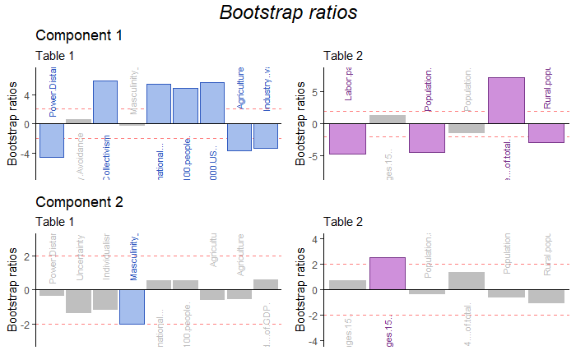

Slide 50
MFA
Let’s combine data 1 and data 2
We have made 3 datasets GDP(data1), POPULATIONS (data2) and USAGE OF SMARTPHONES (data3).

Slide 51
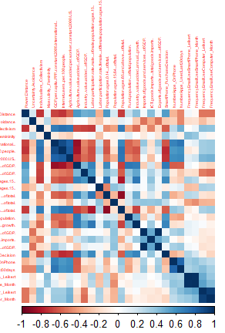
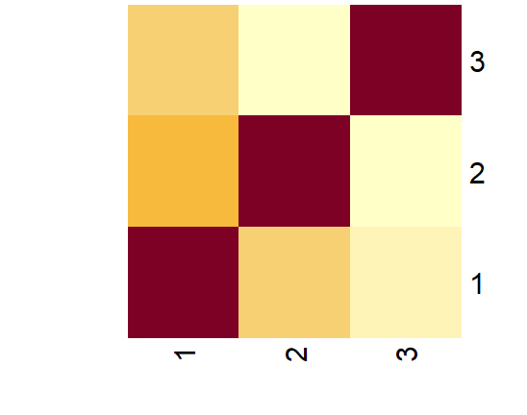
COR PLOT
DATA 3 COR TO DATA 1 MORE THAN DATA 2
DATA 2 AND DATA 1 ARE COR

Slide 52
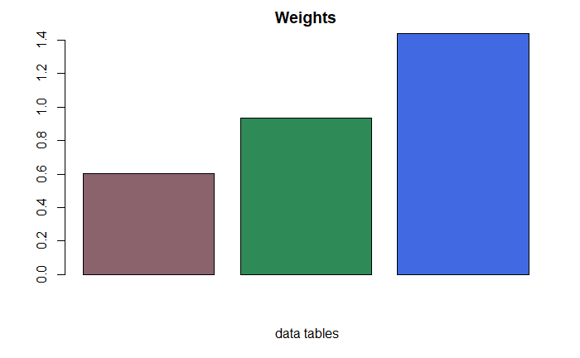

Slide 53
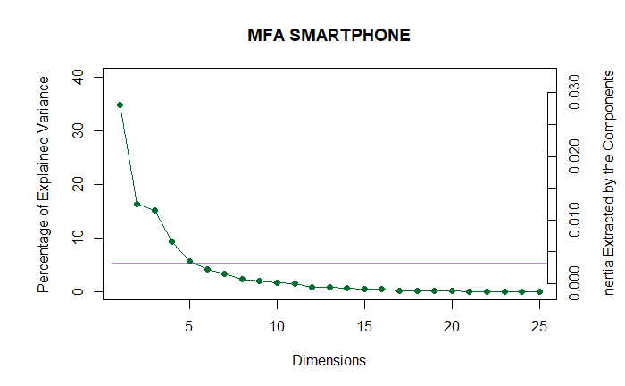

Slide 54
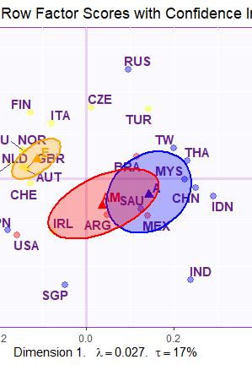
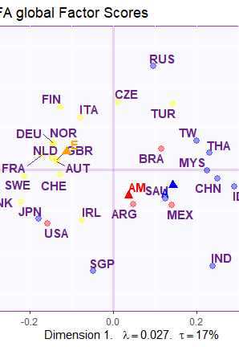

Slide 55
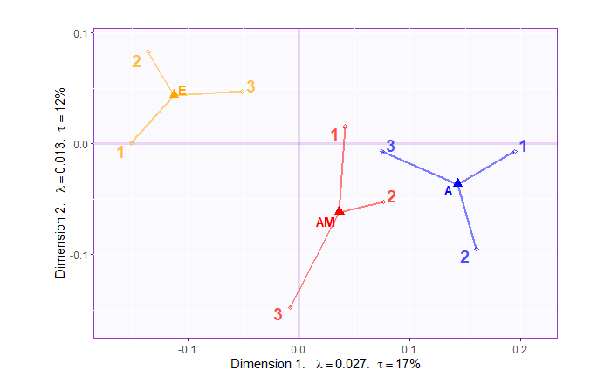

Slide 56
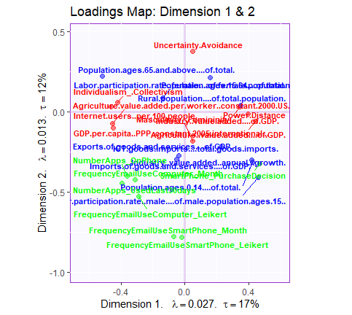
LOADINGS

Slide 57
CONCLUSION
So European countries are different from other continents in terms of GDP factors and population factors and Purchase decision
American and Asian countries are same according to dim 1
USA is again closer to European countries according to dim 1
European countries are different from other continents in terms of Smartphones usage also. American and Asian countries are same according to dim 2
USA is again closer to European countries according to dim 2
Loadings:
Purchase Decision is mainly related to GDP and population factors

Slide 58
Should we reject the null hypothesis or not?
Bootstrap will answer this .

Slide 59
